Slide 1
Associative Memory

Slide 2
Need of Associative Memory
Many data-processing applications require the search of items in a table stored in memory.
Example: An assembler program searches the symbol address table in order to extract the symbol's binary equivalent. An account number may be searched in a file to determine the holder's name and account status.
The established way to search a table is to store all items where they can be addressed in sequence.
The search procedure is a strategy for choosing a sequence of addresses, reading the content of memory at each address, and comparing the information read with the item being searched until a match occurs. The number of accesses to memory depends on the location of the item and the efficiency of the search algorithm.
Many search algorithms have been devel­oped to minimize the number of accesses while searching for an item in a random or sequential access memory.
The time required to find an item stored in memory can be reduced considerably if stored data can be identified for access by the content of the data itself rather than by an address.

Slide 3
Associative Memory and its importance
A memory unit accessed by content is called an associative memory or content addressable memory (CAM).This type of memory is accessed simultaneously and in parallel on the basis of data content rather than by specific address or location.
When a word is written in an associative memory, no address is given. The memory is capable of finding an empty unused location to store the word.
When a word is to be read from an associa­tive memory, the content of the word, or part of the word, is specified.
The memory locates all words which match the specified content and marks them for reading. Because of its organization, the associative memory is uniquely suited to do parallel searches by data association. Moreover, searches can be done on an entire word or on a specific field within a word.
An associative memory is more expensive than a random access memory because each cell must have storage capability as well as logic circuits for matching its content with an external argument. For this reason, associative memories are used in applica­tions where the search time is very critical and must be very short.

Slide 4
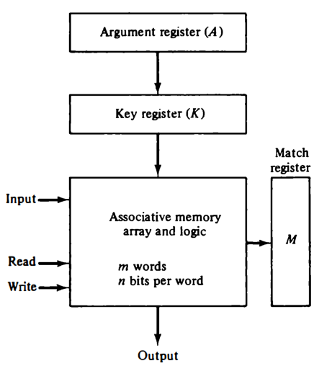
Hardware Organization
The block diagram of an associative memory is shown in Fig.
It consists of a memory array and logic for m words with n bits per word.
The argument register A and key register K each have n bits, one for each bit of a word.
The match register M has m bits, one for each memory word.
Each word in memory is compared in parallel with the content of the argument register.
The words that match the bits of the argument register set a corresponding bit in the match register.

Slide 5
After the matching process, those bits in the match register that have been set indicate the fact that their corresponding words have been matched.
Reading is accomplished by a sequential access to memory for those words whose corresponding bits in the match register have been set.
The key register provides a mask for choosing a particular field or key in the argument word.
The entire argument is compared with each memory word if the key register contains all l' s.
Otherwise, only those bits in the argument that have l's in their corresponding position of the key register are compared.
Thus the key provides a mask or identifying piece of information which specifies how the reference to memory is made.

Slide 6
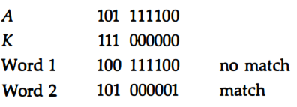
To illustrate with a numerical example, suppose that the argument register A and the key register K have the bit configuration shown below. Only the three leftmost bits of A are compared with memory words because K has 1's in these positions.
Word 2 matches the unmasked argument field because the three leftmost bits of the argument and the word are equal.

Slide 7
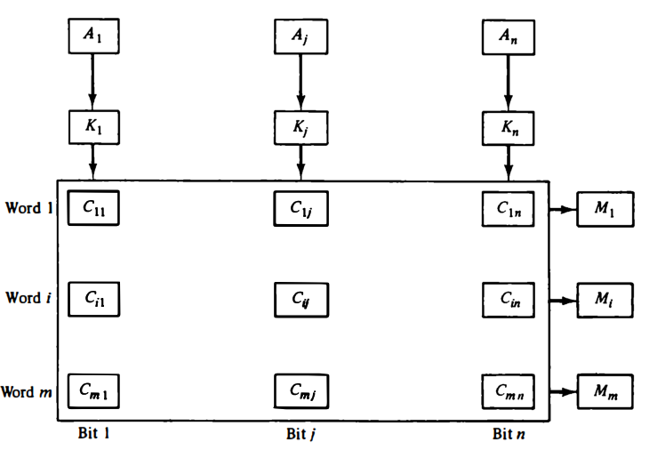
The relation between the memory array and external registers in an associative memory is shown in Fig.
The cells in the array are marked by the letter C with two subscripts.
The first subscript gives the word number and the second specifies the bit position in the word.
Thus cell C9 is the cell for bit j in word i.
A bit Ai in the argument register is compared with all the bits in column j of the array provided that Ki = 1.
This is done for all columns j = 1, 2, . .., n.
If a match occurs between all the unmasked bits of the argu­ment and the bits in word i, the corresponding bit M1 in the match register is set to 1.
If one or more unmasked bits of the argument and the word do not match, M1 is cleared to 0.

Slide 8
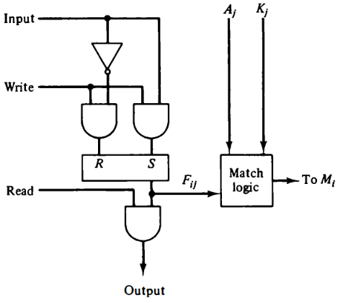
The internal organization of a typical cell C_{ij} is shown in Fig.
It consists of a flip-flop storage element F_{ij} and the circuits for reading, writing, and matching the cell.
The input bit is transferred into the storage cell during a write operation.
The bit stored is read out during a read operation.
The match logic compares the content of the storage cell with the corresponding un­masked bit of the argument and provides an output for the decision logic that sets the bit in M,.

Slide 9


Match Logic
The match logic for each word can be derived from the comparison algorithm for two binary numbers.
First, we neglect the key bits and compare the argu­ment in A with the bits stored in the cells of the words.
Word i is equal to the argument in A if Aj = Fij for j = 1, 2, ... , n.
Two bits are equal if they are both 1 or both 0. The equality of two bits can be expressed logically by the Boolean function
where xj = 1 if the pair of bits in position j are equal; otherwise, xj = 0.
For a word i to be equal to the argument in A we must have all xj variables equal to 1.
This is the condition for setting the corresponding match bit Mi to 1.
The Boolean function for this condition is
and constitutes the AND operation of all pairs of matched bits in a word.

Slide 10
Cache Memory
Analysis of a large number of typical programs has shown that the references to memory at any given interval of time tend to be confined within a few localized areas in memory. This phenomenon is known as the property of locality of reference.
The reason for this property may be understood considering that a typical computer program flows in a straight-line fashion with program loops and subroutine calls encountered frequently.
When a program loop is executed, the CPU repeatedly refers to the set of instructions in memory that constitute the loop. Every time a given subroutine is called, its set of instruc­tions are fetched from memory. Thus loops and subroutines tend to localize the references to memory for fetching instructions.
To a lesser degree, memory references to data also tend to be localized. Table-lookup procedures repeat­edly refer to that portion in memory where the table is stored. Iterative proce­dures refer to common memory locations and array of numbers are confined within a local portion of memory.
The result of all these observations is the locality of reference property, which states that over a short interval of time, the addresses generated by a typical program refer to a few localized areas of memory repeatedly, while the remainder of memory is accessed relatively infrequently.

Slide 11
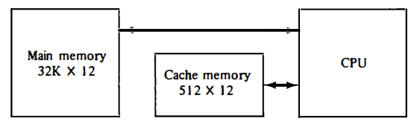
If the active portions of the program and data are placed in a fast small memory, the average memory access time can be reduced, thus reducing the total execution time of the program.
Such a fast small memory is referred to as a cache memory.
It is placed between the CPU and main memory as illustrated in Fig.
The cache memory access time is less than the access time of main memory by a factor of 5 to 10. The cache is the fastest component in the memory hierarchy and approaches the speed of CPU components.
The fundamental idea of cache organization is that by keeping the most frequently accessed instructions and data in the fast cache memory, the average memory access time will approach the access time of the cache. Although the cache is only a small fraction of the size of main memory, a large fraction of memory requests will be found in the fast cache memory because of the locality of reference property of programs.

Slide 12
Basic Operation of Cache
The basic operation of the cache is as follows.
When the CPU needs to access memory, the cache is examined. If the word is found in the cache, it is read from the fast memory.
If the word addressed by the CPU is not found in the cache, the main memory is accessed to read the word.
A block of words containing the one just accessed is then transferred from main memory to cache memory.
The block size may vary from one word (the one just accessed) to about 16 words adjacent to the one just accessed.
In this manner, some data are transferred to cache so that future references to memory find the required words in the fast cache memory.

Slide 13
Performance of Cache
The performance of cache memory is frequently measured in terms of a quantity called hit ratio.
When the CPU refers to memory and finds the word in cache, it is said to produce a hit.
If the word is not found in cache, it is in main memory and it counts as a miss.
The ratio of the number of hits divided by the total CPU references to memory (hits plus misses) is the hit ratio.
The hit ratio is best measured experimentally by running representative programs in the computer and measuring the number of hits and misses during a given interval of time.
Hit ratios of 0.9 and higher have been reported. This high ratio verifies the validity of the locality of reference property.
The average memory access time of a computer system can be improved considerably by use of a cache.
If the hit ratio is high enough so that most of the time the CPU accesses the cache instead of main memory, the average access time is closer to the access time of the fast cache memory.
For example, a computer with cache access time of 100 ns, a main memory access time of 1000 ns, and a hit ratio of 0.9 produces an average access time of 200 ns.
This is a considerable improvement over a similar computer without a cache mem­ory, whose access time is 1000 ns.

